Slide 1

An Analysis of NHANES Health Data 2013-2014
Nino Orton-Clarke

Slide 2
INTRODUCTION
What is NHANES?
a program of studies designed to assess the health/nutritional status of American population.
Purpose of Analysis?
To determine which factors, contribute to being healthy/unhealthy.
3 Health Metrics:
Diastolic blood pressure – resting blood pressure.
Grip Strength – good test of physical health, related to heart health & muscular force.
BMI – Body Mass Index.

Slide 3
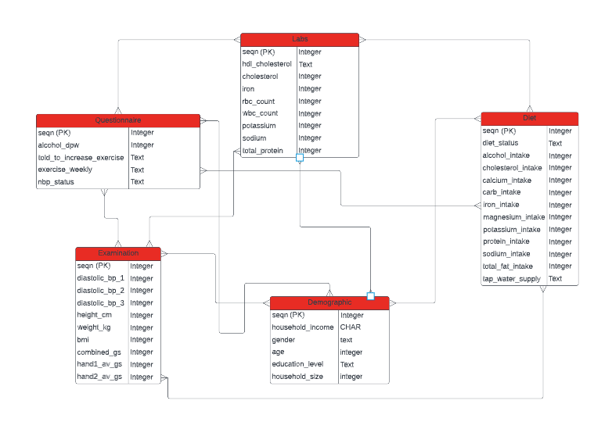
ENTITY RELATIONSHIP DIAGRAM

Slide 4
STEPS TAKEN
DATA CLEANSING
IMPLEMENTATION
QUERIES
ANALYSIS
FINDINGS/CONCLUSIONS

Slide 5
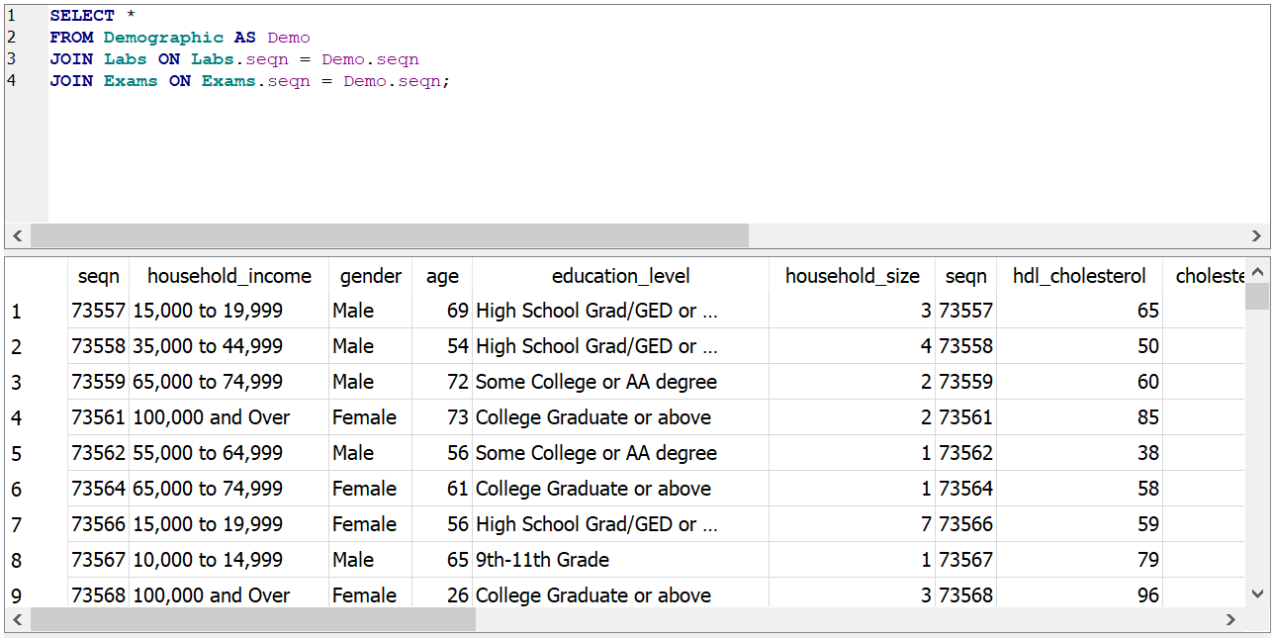
EXAMPLE QUERY

Slide 6
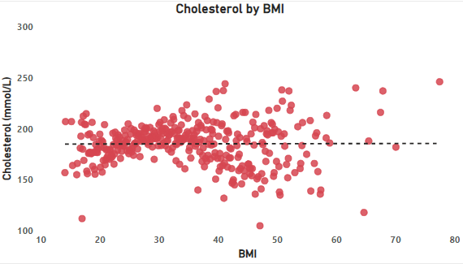
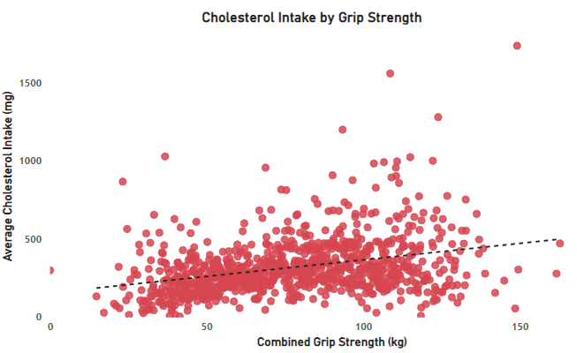
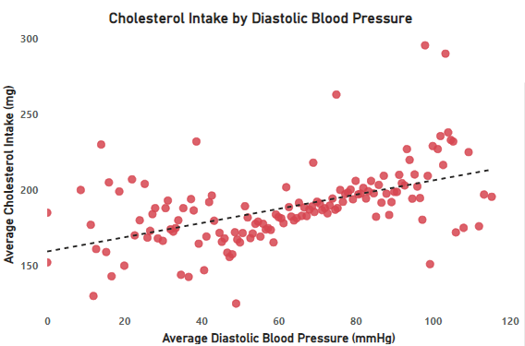
DIET - CHOLESTEROL
No correlation shown between cholesterol levels & BMI.
Positive correlation between cholesterol intake and grip strength.
Positive correlation - diastolic blood pressure generally increases with cholesterol intake as expected.

Slide 7
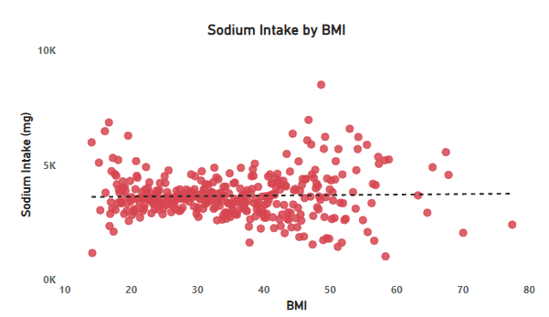
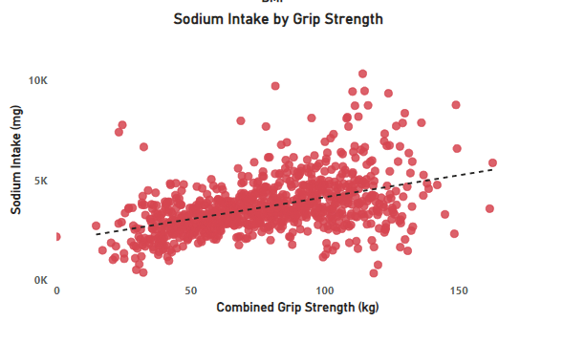
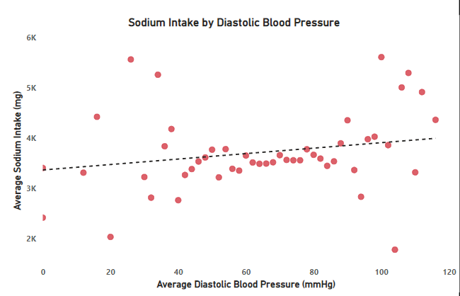
DIET - SODIUM
No correlation found between sodium intake and BMI.
Relatively strong positive correlation between sodium intake and grip strength.
Slight positive correlation between sodium intake and blood pressure.
Findings seem to mirror that of cholesterol.

Slide 8
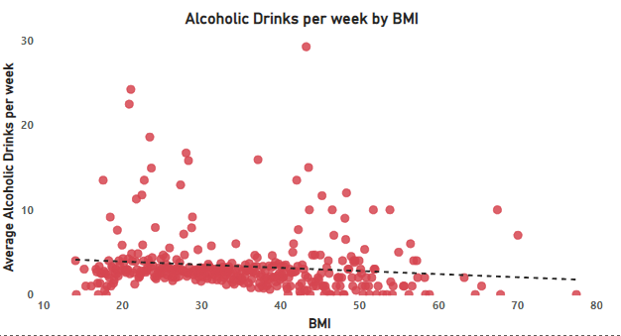
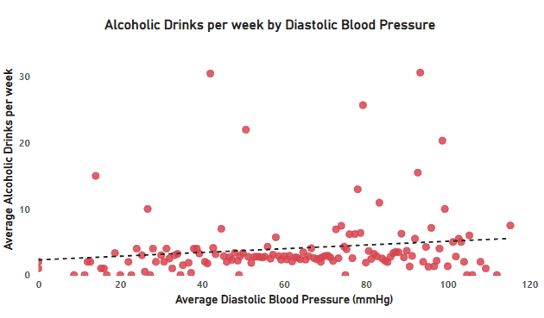
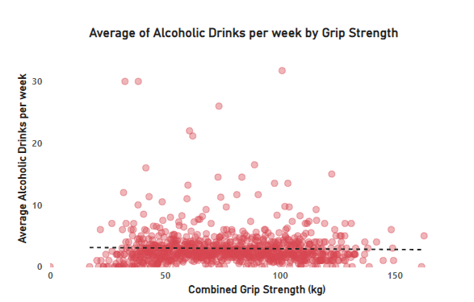
DIET - ALCOHOL
Slight negative correlation between drinks per week and BMI.
Slight positive correlation between alcohol consumption and blood pressure.
In general, strong/clear correlations found between alcohol consumption and the health metrics presented.

Slide 9
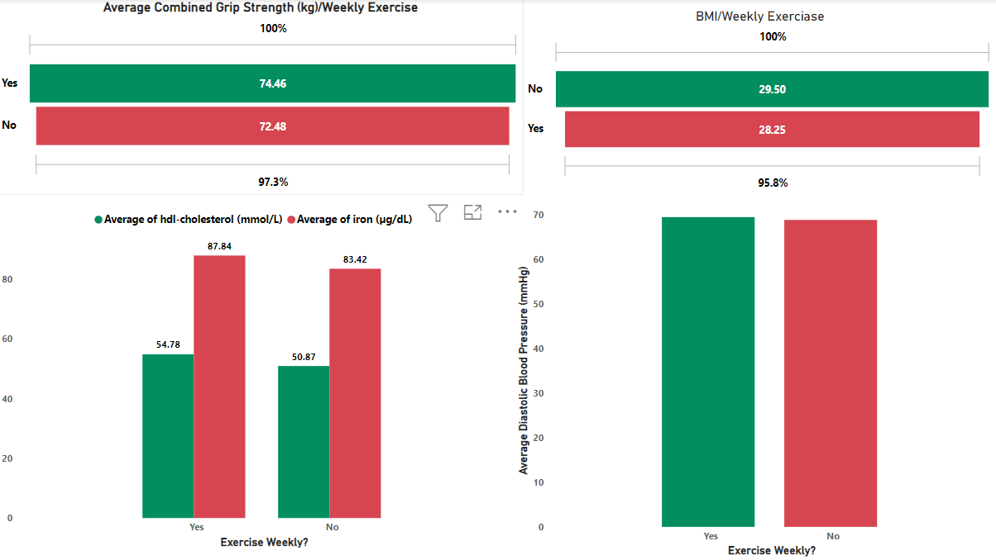
EXERCISE
Mainly minor affects shown by weekly exercise.
Greater grip strength and lower BMI – not significantly.
No difference in DBP - Could be an effect of fitness.
Higher proportion of HDL Cholesterol & Iron.

Slide 10
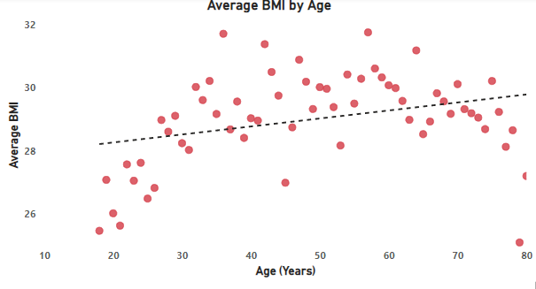
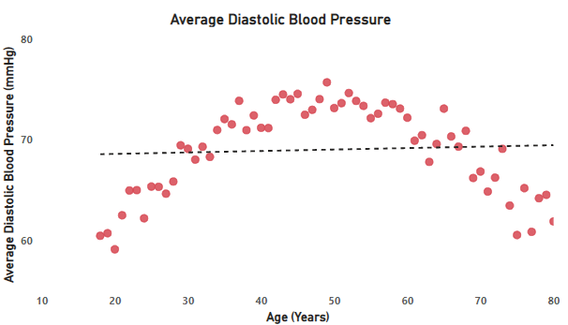
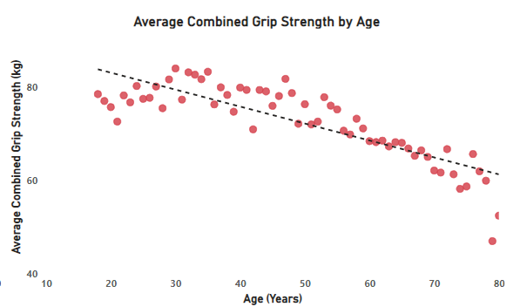
DEMOGRAPHIC - AGE
Positive correlation BMI increases with age.
Diastolic blood pressure increases and then decreases in old age.
Grip strength decreases with age.

Slide 11
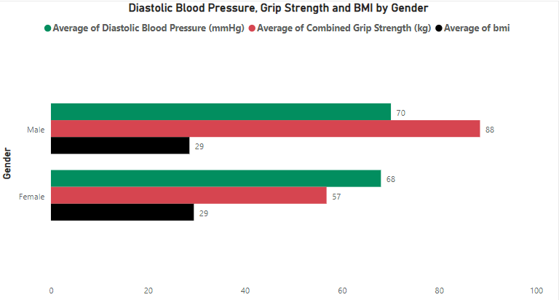
DEMOGRAPHIC - GENDER
No real difference in blood pressure or BMI
Significant difference in grip strength.

Slide 12
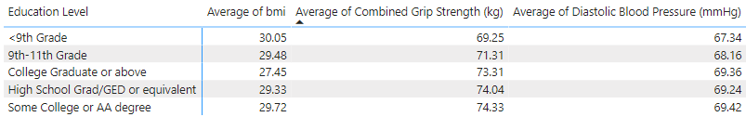
DEMOGRAPHIC – EDUCATION LEVEL
<9 Grade demographic, highest BMI (obese), lowest grip strength but lowest blood pressure.
College grad or above lowest BMI.

Slide 13
Conclusion/Findings
Cholesterol and sodium have similar affects on the body.
Alcohol had no drastic affect on health metrics.
Exercising weekly shows a slight positive affect.
Age naturally had negative impacts.
Gender has no significant impact on health.
Lesser educated people may have more health issues.

Slide 14
LIMITATIONS AND IMPROVEMENTS
Questionnaire table data was sparse – hard to identify lifestyle/habits.
Important health markers like Troponin were not tested for – could improve health metrics.
Include more data on disabilities and medical conditions.

Slide 15

THANK YOU FOR LISTENING

